Slide 1
Stopping By Woods on a Snowy Evening
Robert Frost
1923

Slide 2
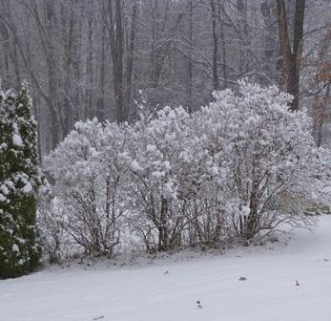
Whose woods these are I think I know. His house is in the village though;

Slide 3
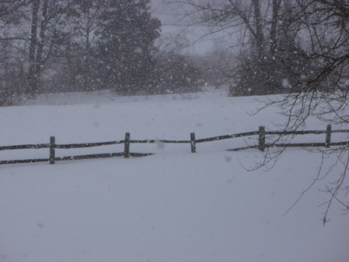
He will not see me stopping here To watch his woods fill up with snow.

Slide 4
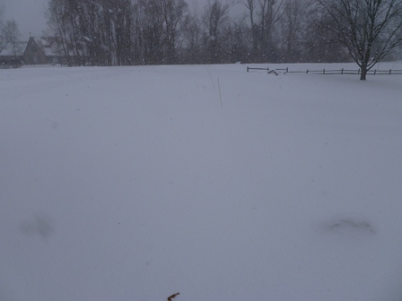
My little horse must think it queer To stop without a farmhouse near

Slide 5
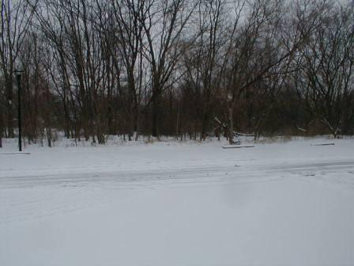
Between the woods and frozen lake The darkest evening of the year.

Slide 6
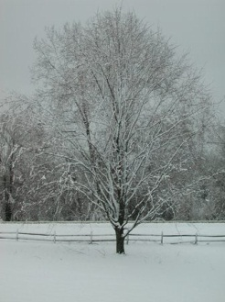
He gives his harness bells a shake To ask if there is some mistake.

Slide 7
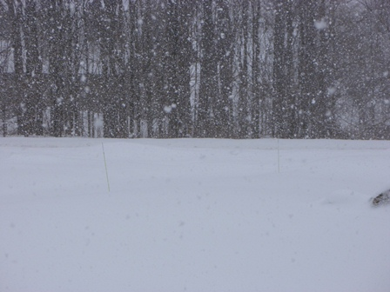
The only other sound's the sweep Of easy wind and downy flake.

Slide 8
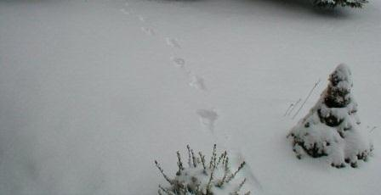
The woods are lovely, dark and deep. But I have promises to keep,

Slide 9
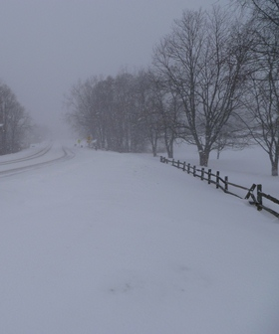
And miles to go before I sleep, And miles to go before I sleep.

