Slide 1
Charlotte’s Website
From the farm to you table
That’s Fresh!

Slide 2
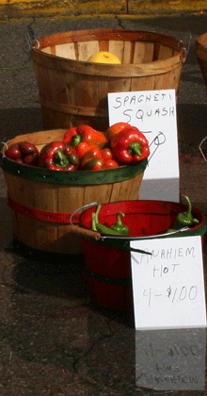
New Product Ideas
Charlotte’s Kitchen | Dessert Ideas | Comments
 | Apple Cider Crisp | Apples in stock
 | Kiwi Lime Pie | Kiwis in stock
 | Banana Fana Mo | No Bananas

Slide 3
Ideas Add Up

